Slide 1
Sentimental analysis
CAPSTONE PROJECT
Presented By:
Student Name: SAI KUMAR REDDY CHINTAKUNTA
College Name: KRISHNA UNIVERSITY COLLEGE OF ENGINEERING AND TECHNOLOGY
Department: CSE

Slide 2
OUTLINE
Problem Statement
Proposed System/Solution
System Development Approach
Algorithm & Deployment
Result
Conclusion
Future Scope
References

Slide 3
Problem Statement
The goal is to Develop a sentiment analysis model to classify restaurant reviews as positive or negative
With the rapid growth of online platforms for sharing opinions and reviews, restaurants often rely
on the customer feedback to improve their services and attract a new customers.
Analyzing the sentiment of these reviews can provide valuable insights into customer satisfaction.

Slide 4
Proposed Solution
To develop a robust sentiment analysis system for classifying customer feedback into positive, negative, or neutral categories. This solution will utilize natural language processing (NLP) techniques and Machine learning models to analyze textual data from customer reviews and feedback.
Data Collection
The data scripts to scrape online review platforms like Google Maps, or Zomato…etc Data preprocessing
The step involves cleaning and preparing the text data for analysis is Lowercasing, Punctuation Removal, Stop Word Removal…etc..,
Machine Learning algorithms
some popular algorithms for sentiment classification is Support Vector Machines (SVM) ,Navie Bayes, Logistic Regression, Neural Networks etc…,
Deployment
Once the model is trained, the model can deploy it in different ways by using web applications and API interfaces…etc,

Slide 5
System Approach
System Requirements :
Python 3 version
Libraries : Pandas ,NumPy , Sklearn , nltk , Matplotlib
Library Requirements:
Pandas : Data Manipulation
Numpy : Numerical Computation
Sklearn : Machine Learning Algorithms
nltk : Natural Language Processing
Matplotlib : Data Visualization

Slide 6
System Approach
Machine learning Algorithms:
Naive Bayes: A simple and efficient classifier that works well for text classification tasks.
Support Vector Machines (SVM): Powerful for classifying text data with high dimensionality.
Logistic Regression: Well-suited for binary classification tasks like positive/negative sentiment.
Neural Networks: Deep learning techniques like Recurrent Neural Networks (RNNs) and Long Short-Term Memory (LSTM) can capture complex
relationships within text data, potentially leading to higher accuracy.
Deployment:
Data Input : Text Reviews
Test-Train Split: Divide your data into training and testing sets. Train the model on the training set and evaluate its performance on the
testing set. This helps avoid overfitting, where the model performs well on the training data but poorly on unseen data.
Confusion Matrix: This visualization tool helps understand how often your model correctly classified reviews and where it made mistakes
Prediction Process :
Input : New Restaurant Review
Output : Sentiment Classification (Positive/ Negative)

Slide 7
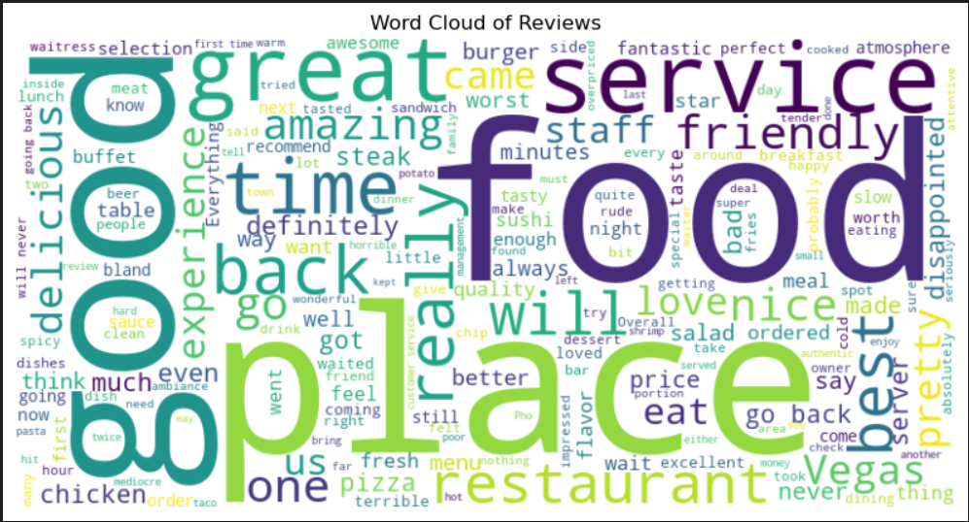
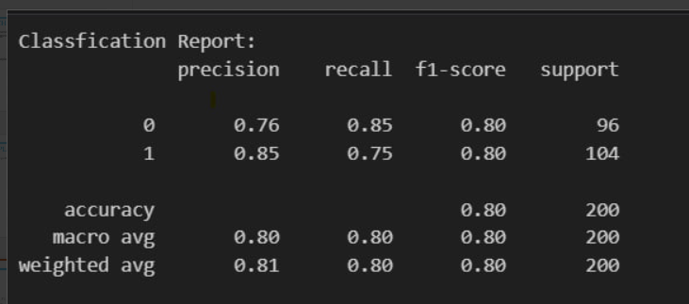
Result
The result of sentiment analysis on a restaurant review can be:
Positive Sentiment: The review expresses satisfaction with the food,
service, ambiance, or overall experience. Words like "delicious",
"excellent", "friendly", “amazing" might indicate a positive review.
Negative Sentiment: The review expresses dissatisfaction with the food, service, ambiance, or overall experience. Words like "terrible", "disappointed", "rude", "unclean“ might indicate a negative review.
Final Result:
Model Accuracy : 85%
Performance Metrics : Precision, Re-call, F1-Measure
Visulization : Confusion Matrix , ROC Curve

Slide 8
Conclusion
Sentiment analysis of restaurant reviews has proven to be a valuable tool for businesses in the restaurant industry. It allows them to:
Gain insights into customer feedback: By analyzing the sentiment of reviews, restaurants can understand what customers like and dislike about their experience. This information can be used to identify areas for improvement, such as the quality of food, service attentiveness, or ambiance.
Track customer sentiment over time: Analyzing trends in review sentiment can help restaurants see how customer perception evolves over time. This can be helpful in identifying areas where the restaurant is excelling or areas that need more attention.
Prioritize responding to reviews: Sentiment analysis can help restaurants prioritize which reviews need a response from management. Negative reviews, or even strongly positive ones, might warrant a response to acknowledge the customer's experience and show appreciation or address any concerns.
Improve overall customer satisfaction: By understanding customer sentiment and taking action based on feedback, restaurants can work towards improving overall customer satisfaction, which can lead to increased customer loyalty and positive word-of-mouth marketing.

Slide 9
Future scope
The field of sentiment analysis is rapidly evolving, and there are numerous areas for future development and enhancement and advanced Techniques.
Leveraging NLP (Natural Language Processing): Advanced NLP techniques can handle complex language structures, sarcasm, and slang more effectively, leading to more accurate sentiment analysis.
Combining Data Sources: Integrating sentiment analysis with sales figures, social media mentions, and online reservation data can create a holistic view of customer sentiment and restaurant performance. This allows for identifying correlations and strategic decision-making.

Slide 10
References
Online Courses and Tutorials: “Natural Language Processing with Classification and Vector Spaces” by deeplearning.ai
“Machine Learning Algorithms And Techniques” by IBM tutorials
Input of dataset from Kaggle : “Restaurant Review”
By referring to these resources, We can gain a deep understanding of sentiment analysis, stay updated with the latest advancements, and effectively implement sentiment analysis systems.

Slide 11
THANK YOU

